Slide 1

SOCIAL SENTIMENT ANALYSIS ON TWITTER DATA
Course - 27960
Group 9 - Midterm Project
Presented By:
NAYANA MAHAJAN
MELIKA ZANDIKARIMI
SHUBHAM SAWANT

Slide 2

TABLE OF CONTENTS
INTRODUCTION
PROBLEM DEFINITION/HYPOTHESIS
DATA SOURCE
METHODOLOGY
EXPLORATORY DATA ANALYSIS
VISUALIZATION
CONCLUSION
REFERENCE

Slide 3
INTRODUCTION
Twitter is a popular platform that allows millions of users to express their emotions by creating status messages called “tweets”
In this presentation, we aim to perform social sentiment analysis on tweets related to the Ukraine war. And check the polarity being positive, negative, and neutral based upon people’s emotions using Vader sentimental analysis on python.
And to determine the attitude of the tweets is positive, negative, or neutral towards the subject of the tweet.

Slide 4

PROBLEM DEFINITION
Due to the current war-like situation and lots of people around the world have been expressing different sentiments on social media such as Twitter.
Social media has played a significant role during all such major events which have driven researchers to analyze with NLP and machine learning methods.
Social media posts and tweets brings another level of understanding when combined with sentiment analysis.
Our Aim is to perform social sentiment analysis on Twitter data for Ukraine War and to evaluate the polarity of the tweets as positive, negative, or neutral.
.

Slide 5
DATA SOURCE
Data is Extracted from Twitter API. (Requires a Twitter Developer Account with API Key and Consumer key)
Tweets are converted to a Data frame in Google Colab with Pandas
Used Vader from NLTK for Sentiment Analysis
Data Cleaning process is performed in python
Data Visualization is performed using Matplotlib, Seaborn, and Word Cloud

Slide 6



METHODOLOGY
DATA CLEANING AND PROCESSING USING PYTHON
API
EDA
Sentiment Analysis

Slide 7
EXPLORATORY DATA ANALYSIS (EDA)
For EDA we have used VADER Sentiment Intensity Analyzer from Natural Language Toolkit (NLTK) Library
That shows 589 (29.4%) of tweets include Positive sentiment, 910 (45.5%) of tweets include Negative sentiment and 501 (25.1%) of tweets include Neutral sentiment
We also cleaned the data creating a new data frame (tweets_clean) and a new feature(tweets)
then clean tweets by using lambda function and clean RT in front of tweets, URL links,
punctuations characters and convert to lowercase
After cleaning the data we analyzed the sentiments again
Found the most used words in the tweets
Created a word cloud out to cleaned tweets, Positive tweets data frame and Negative tweets data frame
Used CountVectorizer to transform a given text into a vector on the basis of the frequency (count) of each word that occurs in the entire text.

Slide 8
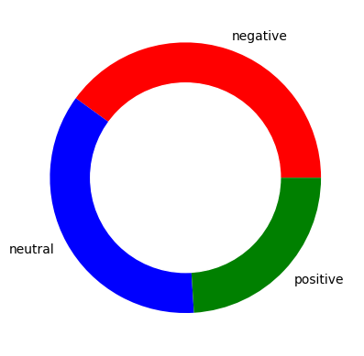
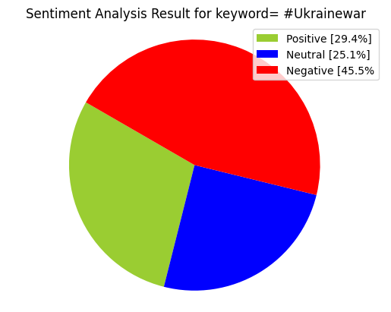
VISUALIZATION
PIE CHART

Slide 9
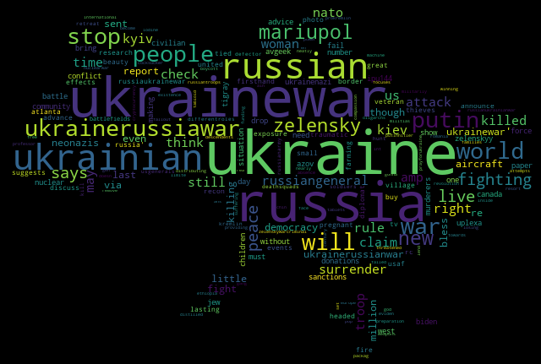
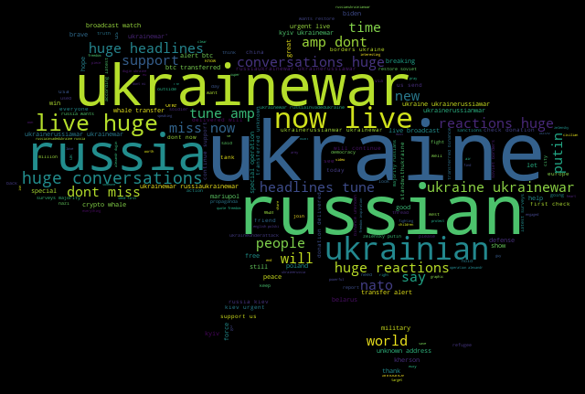
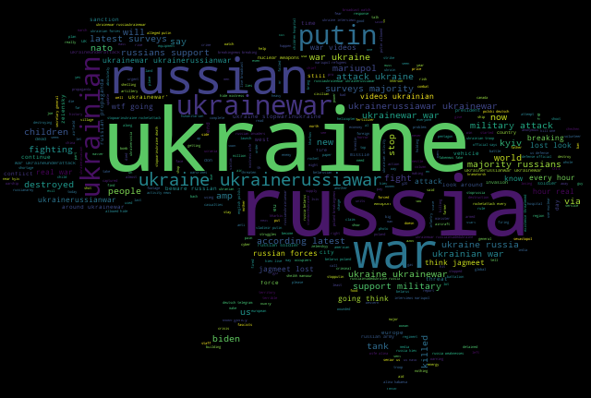
VISUALIZATION
WORD CLOUD
Neutral
Positive
Negative

Slide 10
VISUALIZATION
WORD CLOUD
Positive

Slide 11
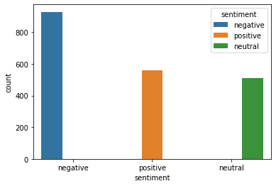
VISUALIZATION
SEA BORN COUNT PLOT
Sentiment 0 = Neutral
Sentiment 1 = Positive
Sentiment 2 = Negative

Slide 12
CONCLUSION
We have analyzed the Twitter data and we found out that sentiment amongst the people is Negative towards the Ukraine war. (which it should be)
Sentiment score percent of the Twitter dataset are:
Negative - 45.5%
Positive - 29.4%
Negative - 25.1%
Most used words are Ukraine, Ukraine war, Russia, Russia, war, Ukraine Russia war, Ukrainian, Putin, huge, etc.
Most used Hashtags are #Ukrainewar #Ukrainewar, #putin, #poland, #russia, #ukraninan #ukrainerussia war

Slide 13
REFRENCES
Sentiment Analysis of Twitter Data published by Sahar A. El Rahman; Feddah Alhumaidi AlOtaibi; Wejdan Abdullah AlShehri
Sentiment Analysis of Twitter Data | IEEE Conference Publication | IEEE Xplore (pace.edu)
Real Time Sentiment Analysis Of Twitter Posts | by V. Prakruthi; D. Sindhu; Dr. S. Anupama Kumar
Sentiment_Analysis_In_Twitter_Using_Lexicon_Based_and_Polarity_Multiplication.pdf
Twitter_Sentiments_Analysis_Using_Machine_Learninig_Methods.pdf

Slide 14

THANK YOU

